Slide 1


Management Information System
User Acceptance of Information Technology: Toward A Unified View
Team 1
M074020029 傅昶曄 M074020024 楊長舜
M074020014 盧怡君 M074020001 尤愛雅
M074020027 洪育勛

Slide 2
CONTENT
Abstract
Review user acceptance literature and discuss eight prominent models Abstract
Empirically compare the eight models and their extensions
Formulate a unified model that integrates elements across the eight models
Empirical Validation of UTAUT
Conclusion

Slide 3

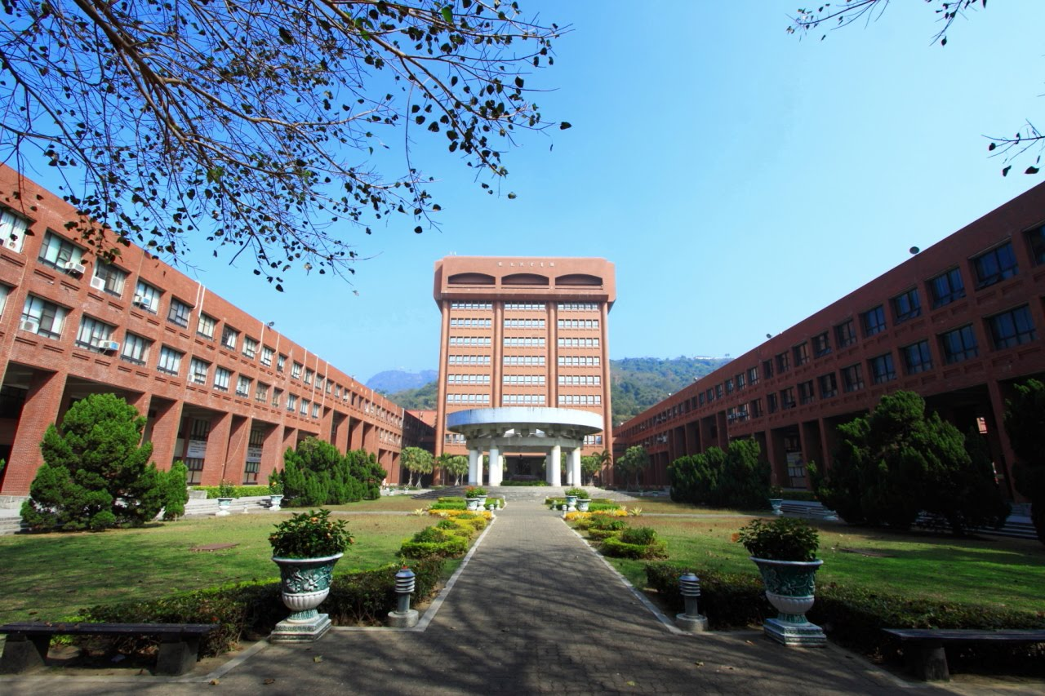
01
Abstract

Slide 4
Introduction
IS research has long studied how and why individuals adopt new information technologies
There are two streams of research：
Individual acceptance of technology about intention or usage
Implementation success at the organizational level and task-technology fit
Notes:
IS研究長期以來一直在研究個體如何以及為何採用新的資訊技術。
在這個廣泛的調查領域內，有幾個研究流派。一個研究流派集中在通過使用意圖或用法作為因變數來個體接受資訊科技的程度。其他流程側重於組織層面的實施成功（Leonard-Barton和Deschamps 1988）和任務技術契合（Goodhue 1995; Goodhue和Thompson 1995）等。雖然這些流中的每一個對用戶接受信息技術的文獻做出了重要且獨特的貢獻，但是包括在本審查，比較和綜合中的理論模型將意圖和/或用法用作關鍵因變量。這裡的目標是將用法理解為因變量。意圖作為行為預測因子（例如，使用）的作用是至關重要的，並且在IS和參考學科中已經很好地建立（參見Ajzen 1991; Sheppard等人1988; Taylor和Todd 1995b）。

Slide 5
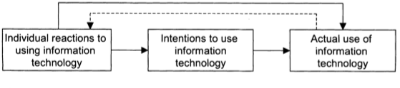
Description of Models and Constructs
Introduction
Figure 1 presents the basic conceptual explaining individual acceptance of information technology that forms the basis of this research
Figure 1. Basic Concept Underlying User Acceptance Models
Notes:
模型和構成元素的描述
Figure 1 展示了一類模型，解釋個體接受資訊技術的基本概念框架，這些技術也構成了本研究的基礎。
Table 1描述了八種主要競爭理論模型，並定義了其使用意圖或用法的理論決定因素。
在八個模型中總共有 32 個 Core Constructs。
表2列出了與這些模型相關的四個關鍵調節變量（經驗，自願性，性別和年齡）。

Slide 6
Abstract
Review user acceptance literature and discuss eight
prominent models
The eight models
the Theory of Reasoned Action (TRA)
the Technology Acceptance Model (TAM)
the Motivational Model (MM)
the Theory of Planned Behavior (TPB)
a model Combining the Technology Acceptance Model and the Theory of Planned Behavior (C-TAM-TPB)
the Model of PC Utilization (MPCU)
the Innovation Diffusion Theory (IDT)
the Social Cognitive Theory (SCT)

Slide 7
Abstract
Empirically compare the eight models and their extensions
data four organizations
six-month period with three points of measurement.
The eight models explained between 17% and 53 % of the variance in user intentions to use information technology.

Slide 8
Abstract
Formulate a unified model that integrates elements
across the eight models
The UTAUT with four core determinants of intention and usage.
And up to four moderators of key relationships.

Slide 9
Abstract
Empirically validate the unified model
UTAUT was then tested using the original data and found to outperform the eight individual models (adjusted R² of 69%).
UTAUT was then confirmed with data from two new organizations with similar results (adjusted R² of 70%)
**(R² , coefficient of determination)=>explainable extent

Slide 10
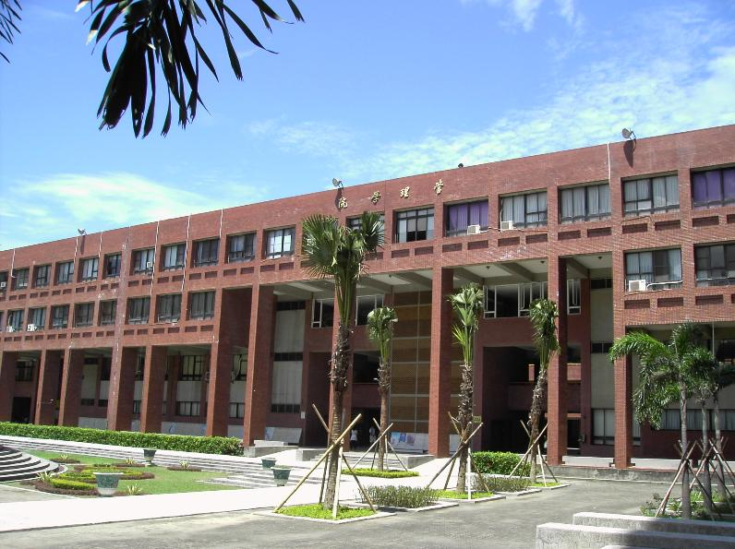
02
Review user acceptance literature and discuss eight prominent models
Prior Model Tests and Model Comparisons, Models and Theories of Individual Acceptance

Slide 11
Models and Theories of Individual Acceptance (1/8)
Model | Core Constructs | Definitions
Theory of Reasoned Action (TRA) | Attitude Toward Behavior | An individual’s positive or negative feelings about performing the target behavior
 | Subjective Norm | The person’s perception that most people who are important to him think he should or should not perform the behavior in question
Notes:
理性行動理論（Theory of Reasoned Action ;TRA）－Fishbein and Ajzen, 1975
→源自社會心理學，是人類行為最基本、影想最深的理論之一。
a.行為態度（attitude toward behavior）：個人對履行目標行為的正、負面感覺。
b.主觀規範（subjective norm）：個人行為態度對他人履行目標行為意願的影響。

Slide 12
Models and Theories of Individual Acceptance (2/8)
Models and Theories of Individual Acceptance (2/8)
Model | Core Constructs | Definitions
Technology Acceptance Model (TAM) | Perceived Usefulness | The degree to which a person believes that using a particular system would enhance job performance
 | Perceived Ease of Use | The degree to which a person believes that using a particular system would be free of effort
 | Subjective Norm | Adapted from TRA/TPB. Included in TAM2 only
Notes:
科技接受模型（Technology Acceptance Model ;TAM）－Davis, 1989
→修訂TRA模型之行為態度構面，以有用及易用之知覺精簡衡量資訊系統的接受度，後於TAM2（Ajzen, 1985）模型加入強制背景（mandatory settings）之主觀規範。
a.知覺有用（perceived usefulness）：對使用特定系統將提高績效之信念（感覺有用）
b.知覺易用（Perceived ease of use）：對使用特定系統不必太費力的信念（感覺好用）
c.主觀規範（subjective norm）；<沿自TRA/TPB，只有TAM2包含>。

Slide 13
Models and Theories of Individual Acceptance (3/8)
Models and Theories of Individual Acceptance (3/8)
Model | Core Constructs | Definitions
Motivational Model (MM) | Extrinsic Motivation | The perception that users want to perform an activity “because it is perceived to be instrumental in achieving valued outcomes that are distinct from the activity itself, such as improved job performance, pay, or promotions
 | Intrinsic Motivation | The perception that users want to perform an activity “for no apparent reinforcement other than the process of performing the activity per se
Notes:
動機模型（Motivational Model ;MM）－Davis et al., 1992
→源自心理學關於行為的詮釋。
a.外在動機（extrinsic motivation）：個人知覺可達成有價值的成果（提升績效、酬勞）
b.內在動機（Intrinsic motivation）：個人志願投入活動本身的知覺，無需外部誘因強化。

Slide 14
Models and Theories of Individual Acceptance (4/8)
Models and Theories of Individual Acceptance (4/8)
Model | Core Constructs | Definitions
Theory of Planned Behavior (TPB) | Attitude Toward Behavior | Adapted from TRA
 | Subjective Norm | Adapted from TRA
 | Perceived Behavioral Control | The perceived ease or difficulty of performing the behavior. In context of IS research, perceptions of internal and external constraints on behavior
Notes:
計畫行為模式（Theory of Planned Behavior ;TPB）－Ajzen, 1991
→為TRA之延伸，加入「知覺行為控制」構面。
a.行為態度（attitude toward behavior）：<沿自TRA>。
b.主觀規範（subjective norm）：<沿自TRA>。
c.知覺行為控制（perceived behavioral control）：內、外部的限制對履行特定行為難易的知覺，因TRA忽略了核心使用者所作的倫理道德決定，特別是個人特點被忽視。

Slide 15
Models and Theories of Individual Acceptance (5/8)
Models and Theories of Individual Acceptance (5/8)
Model | Core Constructs | Definitions
Combined TAM and TPB (C-TAM-TPB) | Attitude Toward Behavior | Adapted from TRA/TPB
 | Subjective Norm | Adapted from TRA/TPB
 | Perceived Behavioral Control | Adapted from TPB
 | Perceived Usefulness | Adapted from TAM
Notes:
結合TAM與TPB（Combined TAM and TPB：C-TAM-TPB）－Taylor and Todd, 1995
→混合兩個模型。
a.行為態度（attitude toward behavior）：<沿自TRA/TPB>。
b.主觀規範（subjective norm）：<沿自TRA/TPB>。
c.知覺行為控制（perceived behavioral control）：<沿自TRA/TPB>。
d.知覺有用（perceived usefulness）：<沿自TAM>。

Slide 16
Models and Theories of Individual Acceptance (6/8)
Models and Theories of Individual Acceptance (6/8)
Model | Core Constructs | Definitions
Model of PC Utilization (MPCU) | Job-fit | The extent to which an individual believes that using [a technology] can enhance the performance of his or her job
 | Complexity | The degree to which an innovation is perceived as relatively difficult to understand and use
 | Long-term Consequences | Outcomes that have a pay-off in the future
 | Affect Towards Use | Feelings of joy, elation, or pleasure, or depression, disgust, displeasure, or hate associated by an individual with a particular act
 | Social Factors | The individual’s internalization of the reference group’s subjective culture, specific interpersonal agreements that the individual has made with others, in specific social situations
 | Facilitating Conditions | Objective factors in the environment that observers agree make an act easy to accomplish
Notes:
PC運用模型（Model of PC Utilization ;MPCU）－Thompson, 1991
→改編自Triandis（1977）的人類行為理論，途徑與TRA/TBP大相逕庭。認為不該用意圖研究使用者行為，而是較公平的IS使用率。
a.職能配適（job-fit）：操作技術會影響職能效率、工作績效的程度。
b.複雜性（complexity）：對創新感到難以瞭解及使用的程度。
c.長期結果（long-term consequences）：將來能夠獲得相對應回報的成果。
d.使用好惡（affect towards use）：對履行特定行動所產生的情緒反應。
e.社會因素（social factors）：個人對主流文化之契合程度。
f.促成條件（facilitating conditions）：環境中有助於完成行動之客觀因素。（環境成本較低時，有利於促進使用者操作）

Slide 17
Models and Theories of Individual Acceptance (7/8)
Models and Theories of Individual Acceptance (7/8)
Model | Core Constructs | Definitions
Innovation Diffusion Theory (IDT) | Relative Advantage | The degree to which an innovation is perceived as being better than its precursor
 | Ease of Use | The degree to which an innovation is perceived as being difficult to use
 | Image | The degree to which use of an innovation is perceived to enhance one’s image or status in one’s social system
 | Visibility | The degree to which one can see others using the system in the organization
 | Compatibility | The degree to which an innovation is perceived as being consistent with the existing values, needs, and past experiences of potential adopters
 | Results Demonstrability | The tangibility of the results of using the innovation, including their observability and communicability
 | Voluntariness of Use | The degree to which use of the innovation is perceived as being voluntary, or of free will
Notes:
創新擴散理論（Innovation Diffusion Theory ;IDT）－Moore and Benbasat, 1991
→參考傳播學者Rogers的理論，並改進了一套可用於研究個人技術接受度的結構。
a.相對優勢（relative advantage）：創新被認為是較過往優越的程度。
b.易用性（ease of use）：對創新感到相對難以使用的程度。
c.形象（image）：對使用創新感到可以提升社會形象或地位的程度。
d.能見度（visibility）：組織內其他人應用創新的能見度。
e.相容性（compatibility）：對創新感到符合既有價值、需求及經驗的一致性。
f.結果明顯性（results demonstrability）：對使用創新結果的可觀察性（有形、有效）、可傳播性。
g.自願性（voluntariness of use）；對使用創新的自願程度。

Slide 18
Models and Theories of Individual Acceptance (8/8)
Models and Theories of Individual Acceptance (8/8)
Model | Core Constructs | Definitions
Social Cognitive Theory (SCT) | Outcome Expectations— Performance | The performance-related consequences of the behavior. Specifically, job-related outcomes
 | Outcome Expectations— Personal | The personal consequences of the behavior. Specifically, individual esteem and sense of accomplishment
 | Self-efficacy | Judgment of one’s ability to use a technology to accomplish a particular job or task.
 | Affect | An individual’s liking for a particular behavior
 | Anxiety | Evoking anxious or emotional reactions when it comes to performing a behavior
Notes:
社會認知理論（Social Cognitive Theory ;SCT）－Compeau and Higgins, 1995
→參考Bandura的理論應用於資訊科技，為了與預測個人接受的精神保持一致，意圖和使用的背景下檢查模型的預測有效性，以便對模型進行公平比較，理論是針對行為而非意圖。（事前、事後）
a.結果預期（outcome expectations-performance）：履行行為結果與績效相關性。
b.個人預期（outcome expectations-personal）：履行行為之結果所帶來的尊重與實現感。
c.自我效能感（self-efficacy）：判斷個人運用科技完成特定工作或任務的能力。
d.個人好惡（affect）：個人對特定行為的愛好程度。
e.焦慮（anxiety）：履行特定行為引起焦慮與不安的程度。

Slide 19
Role of Moderators in Existing Models
Role of Moderators in Existing Models
Model | Experience | Voluntariness | Gender | Age
TRA | More experience Attitude↑ subjective norm ↓ | less Voluntary subjective norm↑ | N/A | N/A
TAM (and TAM2) | More experience ease of use ↓ | Within TAM2 ： Mandatory and limited experience subjective norm ↑ | Men perceived usefulness ↑ Women perceived ease of use ↑ women in the early stages of experience subjective norm ↑ | N/A
MM | N/A | N/A | N/A | N/A
TPB | More experience subjective norm ↓ | less Voluntary subjective norm ↑ | Men attitude ↑ women in early stages of experience Subjective norm ↑ perceived behavioral control ↑ | younger workers Attitude ↑ older workers perceived behavioral control ↑ older women Subjective norm ↑
Notes:
TRA：
經驗未明確包含在原始TRA中。 然而，使用Davis等人的橫斷面分析，經驗性地檢驗了經驗的作用。（1989年）。 沒有發現決定因素顯著性的變化。 相比之下，Karahanna等人。 （1999）發現，隨著經驗的增加，態度更為重要，而隨著經驗的增加，主觀規範變得不那麼重要了。
自願性未包括在原始TRA中。 雖然沒有經過測試，但Hartwick和Barki（1994）認為，當系統使用被認為不那麼自願時，主觀規範就更為重要。
TAM2：
原始TAM中沒有明確包含經驗。 戴維斯等人。 （1989）和Szajna（1996）等人提供了經驗證據表明這一點，隨著經驗的增加，易用性變得無關緊要。
原始TAM中沒有明確包含自願性。 在TAM2中，主觀規範僅在強制性設置中顯著，甚至僅在系統經驗有限的情況下（即，三向交互）。
原始TAM中未包含性別。 經驗證據表明，對於男性來說，感知的有用性更為突出，而對於女性來說，感知的易用性更為突出（Venkatesh和Morris，2000）。 對於處於經驗早期階段的女性（即三向互動），主觀規範的影響更為顯著。
TPB：
經驗未明確包含在原始TPB或DTPB中。 它已通過後續研究納入TPB（例如，Morris和Venkatesh 2000）。 經驗證據表明，經驗調節了主觀規範與行為意圖之間的關係，因此隨著經驗水平的提高，主觀規範變得不那麼重要。 這類似於Karahanna等人的建議。 （1999年）在TRA的背景下
自願性未包括在原始TPB或DTPB中。 正如關於TRA的討論中所指出的那樣，雖然沒有經過測試，但當系統使用被認為不那麼自願時，主觀規範被認為更為重要（Hart-wick和Barki 1994）。
Venkatesh等人。 （2000）發現男性的態度更為突出。 對於處於經驗早期階段的女性（即，三向交互），主觀規範和感知行為控制都更為突出。
Morris和Venkatesh（2000）發現，年輕工人的態度更為突出
雖然感知到的行為控制對於老年工人來說更為突出。 主觀規範對老年女性更為突出（即三方互動）。

Slide 20
Role of Moderators in Existing Models
Role of Moderators in Existing Models
Model | Experience | Voluntariness | Gender | Age
Combined TAM-TPB | Experience was incorporated into this model in a between-subjects design More experience Perceived usefulness ↑ Attitude toward behavior ↑ Perceived behavioral control ↑ Subjective norm ↓ | N/A | N/A | N/A
MPCU | Less experience Complexity ↑ Affect toward use ↑ Social factors ↑ Facilitating conditions ↑ More experience Long-term consequences ↑ | N/A | N/A | N/A
Notes:
C-TAM-TAB：
經驗被納入該模型中的主題間設計（有經驗和沒有經驗的用戶）。 隨著經驗的增加，感知的有用性，對行為的態度和感知的行為控制都變得更加突出，而主觀規範隨著經驗的增加而變得不那麼顯著（Taylor and Todd 1995a）。
MPCU：
湯普森等人。 （1994）發現，玉米複合性，對使用的影響，社會因素和促進條件都更加突出，經驗較少。 另一方面，隨著經驗水平的提高，對長期後果的關注變得越來越重要。

Slide 21
Role of Moderators in Existing Models
Role of Moderators in Existing Models
Model | Experience | Voluntariness | Gender | Age
IDT | the significant predictors： for adoption (no/low experience) relative advantage, ease of use, trial-ability, results demonstrability, and visibility for usage (greater experience) relative advantage and image | Voluntariness was not tested as a moderator, but was shown to have a direct effect on Intention | N/A | N/A
SCT | N/A | N/A | N/A | N/A
Notes:
IDT：
Karahanna等。 （1999）進行了一個主體間的比較，以研究創新特徵對採用（無/低經驗）和使用行為（更大經驗）的影響，並發現採用與使用行為的預測因素存在差異。 結果顯示，對於採用，顯著的預測因子是相對優勢，易用性，試驗能力，結果可證明性和可見性。 相比之下，對於使用，只有相對優勢和形象意義重大。
自願性未作為主持人進行測試，但顯示出直接影響意向。

Slide 22
Review of Prior Model Comparisons
Review of Prior Model Comparisons
Model Comparison Studies | Theories/ Models Compared | Context of Study (Incl.Technology) | Participants | Newness of Technology Studied | Number of Points of Measurement | Cross- Sectional or Longitudinal Analysis | Findings
Davis et al. (1989) | TRA, TAM | Within-subjects intention and use of a word processor | 107 students | new to the technology | 2 → 14 weeks apart | Cross-sectional | The variance in intention and use TRA：32% ,26% TAM：47% , 51%
Mathieson (1991) | TAM, TPB | Between-subjects intention to use a spreadsheet and calculator | 262 students | Some familiarity with the technology | 1 | Cross-sectional | The variance in intention TAM：70% TPB：62%
Taylor and Todd (1995b) | TAM, TPB/DTPB | Within-subjects intention to use a computing resource center | 786 students | Many students were already familiar with the center | For a three-month period | Cross-sectional | The variance in intention TAM：52% TPB：57% DTPB：60%
Plouffe et al. (2001) | TAM, IDT | Within-subjects intention to use in the context of a market trial of an electronic payment system using smart card | 176 merchants | Survey administered after 10 months of use | 1 | Cross-sectional | The variance in intention TAM：33% IDT：45%

Slide 23
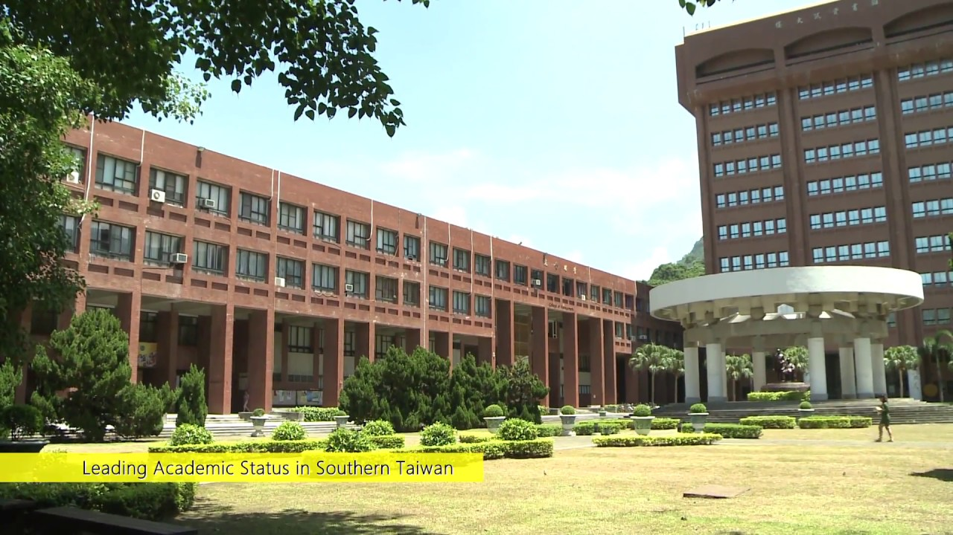
03
Empirical Comparison of the Eight Models
Settings and Participants, Measurement, Result

Slide 24
Prior Model Tests and Model Comparisons
Prior Model Tests and Model Comparisons
Five limitations of prior model tests and comparisons：
Technology studied
Prior：simple, individual-oriented IT
UTAUT： complex, organizational IT, managerial concern
Participants
Prior：most are students
UTAUT： employees in organizations
Timing of measurement
Prior： after the participants’ acceptance or rejection decision
UTAUT： from the initial introduction to stages of greater experience
Notes:
對八種模型進行了許多測試，但只有四項研究報告了在主要信息系統期刊上發表的八種模型中的兩種或更多種的基於經驗的比較。 表3提供了每個模型比較研究的簡要概述。 儘管研究流明顯成熟，但在一項研究中尚未對關鍵競爭模型進行全面比較。 下面，我們確定了這些先前模型測試和比較的五個局限性，以及我們如何解決這些局限性工作。
參與者：雖然在組織環境中對每個模型進行了一些測試，但四個模型比較研究中有三個的參與者只有學生，而Plouffe等人。 （2001）在非學術環境中進行了他們的研究。該研究使用從組織中的員工收集的數據進行。
測量時間：一般來說，八個模型的大部分測試都是在參與者接受或拒絕決定之後，而不是在積極採用決策過程中進行的。由於行為已經變得常規化，因此在這些研究中報告的個體反應是回顧性的（參見Fiske和Taylor 1991; Venkatesh等人2000）。戴維斯等人除外。 （1989），模型比較檢查了在測量時個人已經熟悉的技術。在本文中，我們研究了從最初引入到更多經驗階段的技術。

Slide 25
Prior Model Tests and Model Comparisons
Prior Model Tests and Model Comparisons
Five limitations of prior model tests and comparisons：
Nature of measurement
Voluntary vs. mandatory contexts
Prior：simple, individual-oriented IT
UTAUT： complex, organizational IT, managerial concern
Prior：simple, individual-oriented IT
UTAUT： complex, organizational IT, managerial concern
F
Notes:
測量性質：即使是經驗研究也經常使用橫斷面和/或受試者之間的比較（例如，Davis等人1989; Karahanna等人1999; Szajna 1996; Taylor和Todd 1995a; Thompson等人。 1994年）。此限制也適用於模型比較研究。我們的工作通過新技術跟踪參與者的各個階段的經驗，並比較所有參與者的所有模型。
自願與強制背景：大多數模型測試和所有四種模型比較都是在自願使用環境中進行的。因此，在將這些結果推廣到可能對執業經理更感興趣的強制性設置時，必須謹慎。該研究考察了自願和管理實施背景。

Slide 26
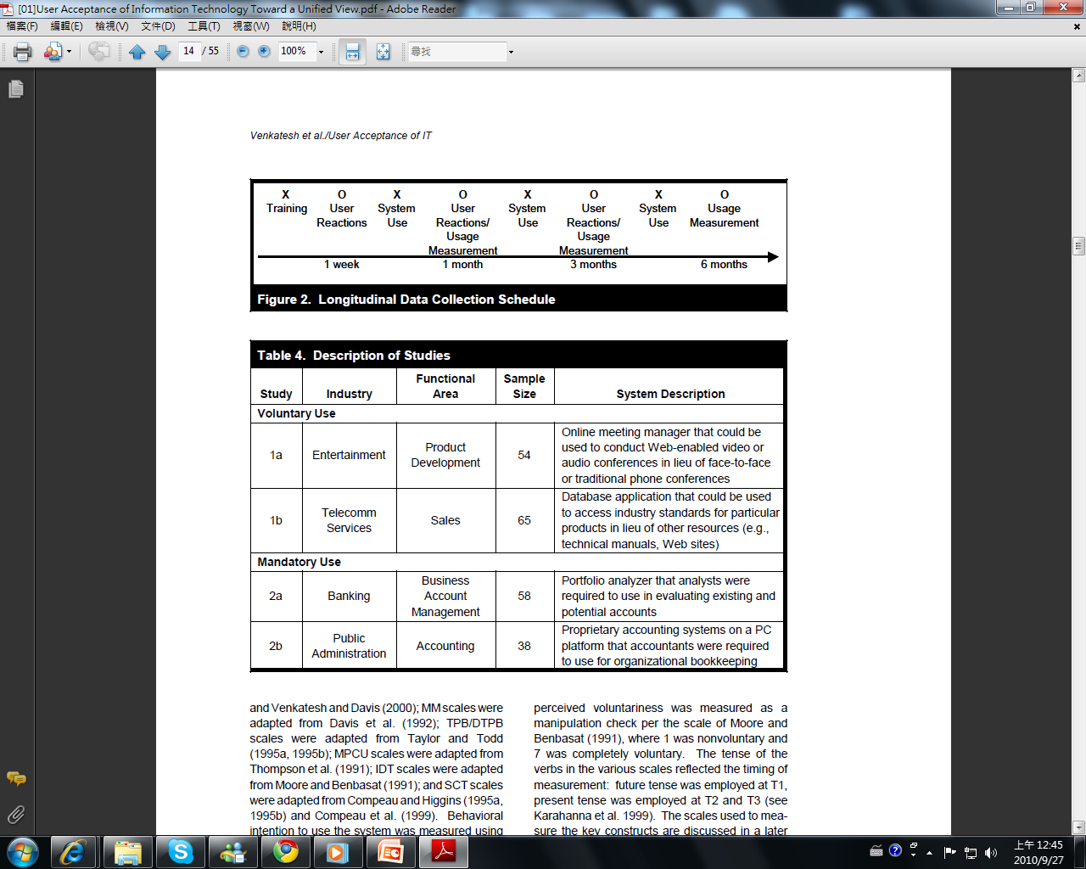
Settings and Participants
Longitudinal field studies were conducted at four organizations among individuals being introduced to a new technology in the workplace.
To help ensure our results would be robust across contexts, we sampled for heterogeneity across technologies, organizations, industries, business functions, and nature of use (voluntary vs. mandatory).
Notes:
有四家組織在長達半年期間進行各個models的實證比較。
這四間組織分為自願性以及強制性兩部分。
而自願性的組織又分為娛樂業，樣本數54以及電信服務業，樣本數65。
強制性的組織則有銀行業，樣本數58及公共行政，樣本數38。

Slide 27
Settings and Participants
Settings and Participants
A pretested questionnaire containing items measuring constructs from all eight models was administered at three different points in time:
T1:post-training
T2:one month after implementation
T3:three month after implementation
Actual usage behavior was measured over the six month post-training period.
Notes:
在六個月的資料蒐集期間內，從導入訓練起到實際使用為止共有三次的測量時
間點：
T1:開始一周後
T2:一個月後
T3:三個月後
而實際的使用行為則在訓練後六個月進行測量。

Slide 28
Measurement
Measurement
TRA－Davis et al.（1989）
TAM－Davis (1989), Davis et al. (1989), Venkatesh and Davis (2000)
MM－Davis et al. (1992)
TPB/DTP－Taylor and Todd（1995)
MPCU－Thompson et al. (1991)
IDT－Moore and Benbasat (1991)
SCT－Compeau and Higgins (1995) and Compeau et al. (1999)
Perceived Voluntariness－Moore and Benbasat (1991)
Notes:
後面的Table 5 6 7的衡量問項的主要來源，分別就是改編自以下等人
例如TRA.TAM.MM改編自Davis等人

Slide 29
Measurement
Measurement
A questionnaire was created with items validated in prior research.
The tense of the verbs in the various scales reflected the timing of measurement: future tense was employed at T1, present tense was employed at T2 and T3.
Actual usage behavior was measured as duration of use via system logs.
in all organizations studied, the system automatically logged off inactive users after a period of 5 to 15 minutes, eliminating most idle time from the usage logs.
Notes:
那所創建的問卷，使用的就是先前研究中所驗證的項目。
先前所提到的測量時間點T1、T2、T3分別有不同的動詞時態：T1使用的是未來式
的問項，T2和T3則是使用現在式的問項。
而實際的使用行為則是在使用的期間中透過系統Logs做測量，並且會排除閒置
過久的使用者(超過5~15分)。

Slide 30
Result
Result
The perceptions of voluntariness were very high in studies 1a and 1b (1a: M = 6.50, SD = 0.22; 1b: M = 6.51, SD = 0.20) and very low in studies 2a and 2b (1a: M = 1.50, SD = 0.19; 1b: M = 1.49, SD = 0.18).
Partial least squares (PLS Graph, Version 2.91.03.04) was used to examine the reliability and validity of the measures.
In testing the various models, only the direct effects on intention were modeled as the goal was to examine the prediction of intention rather than interrelationships among determinants of intention.
Notes:
自願性的組織比起強制性的組織，有著更高度的自由感。
而PLS Graph這個則是用於檢測可靠性和有效性。 具體來說就是在兩個研究(自
願性與強制性)，八個模型，三個測量時間點來檢查收斂和判別有效性。
在測試各種models時，只有模擬會對意圖產生直接的影響，因為我們的目標是
檢查意圖的預測而不是去看意圖的決定因素之間的相互關係。

Slide 31
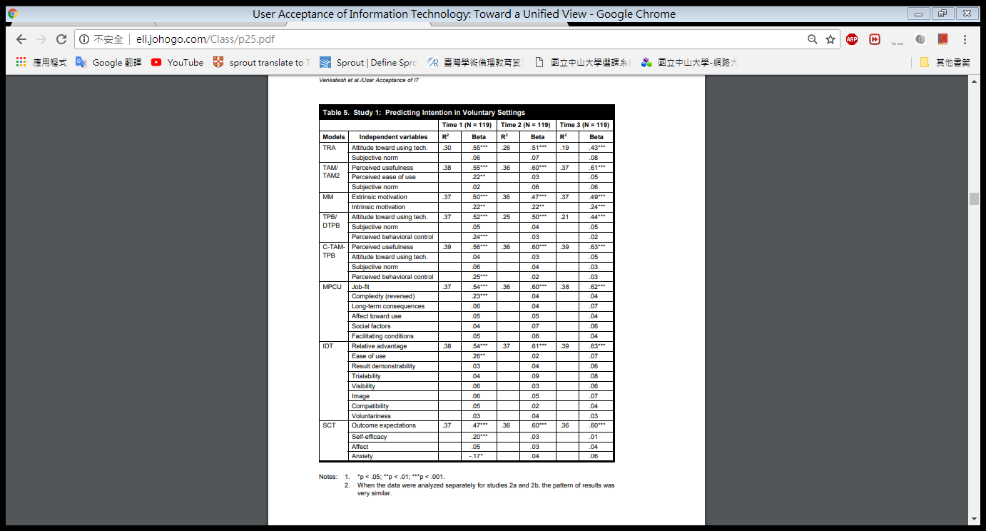

Result
Notes:
TABLE 5為Voluntary Setting，樣本數N的119是來自於TABLE 4中的1a和1b的樣本
數總和。
TABLE 6則為Mandatory Setting，樣本數N的96則為TABLE 4中的2a和2b的樣本數
總和。
我們可以得知八個models對意圖的解釋能力介於17-42%之間。
有些影響意圖的因素會隨著時間的經過而趨弱，也就是說會隨著經驗的
累積而從原本顯著的變為不顯著。

Slide 32
Result
Result
Following the test of the baseline/original specifications of the eight models we examined the moderating influences suggested (either explicitly or implicitly) in the literature:
Voluntariness
Gender
Age
Experience
In order to test these moderating influences, stay true to the model extensions, and conduct a complete test of the existing models and their extensions, the data were pooled across studies and time periods.
Notes:
分別測試了八個models的基本Constructs之後，在Constructs部分加入了四個調
節變數，分別為自願性、性別、年齡、經驗。
加入四個調節變數後使得資料不僅有之前的Constructs，更有先前的Constructs分
別各自乘上四個調節變數後的結果，並將其結果彙集統整於Table 7。

Slide 33
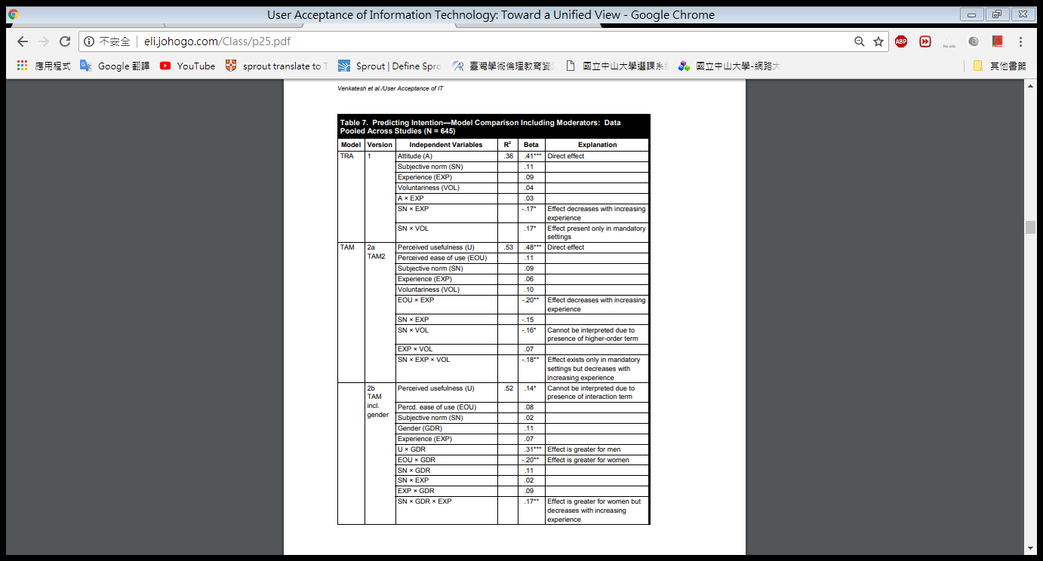
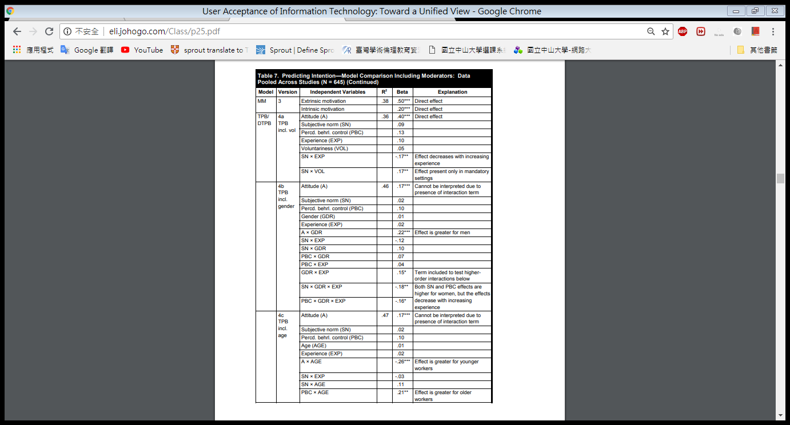
Result
Result
Notes:
Table 7的樣本量N便是Table 5和Table 6的樣本量相加之後乘上三個測試時間點而
得。
可以看到Attitude為原本的Construct，而加上調整變數後變多了A x EXP這個
Construct。

Slide 34
Result
Result
With the exception of MM and SCT, the predictive validity of the models increased after including the moderating variables.
The extensions to the various models identified in previous research mostly enhance the predictive validity of the various models beyond the original specifications.
Notes:
除了MM與SCT之外，其他Models加入調節變數之後，解釋力都提高了，我們以
TAM2當作例子，原本的解釋歷介於17-42%之間，加入調節變數之後則來到了
53%，超出原本的42%。
加入調節變數後的各種models還都提高了預測的有效性。

Slide 35
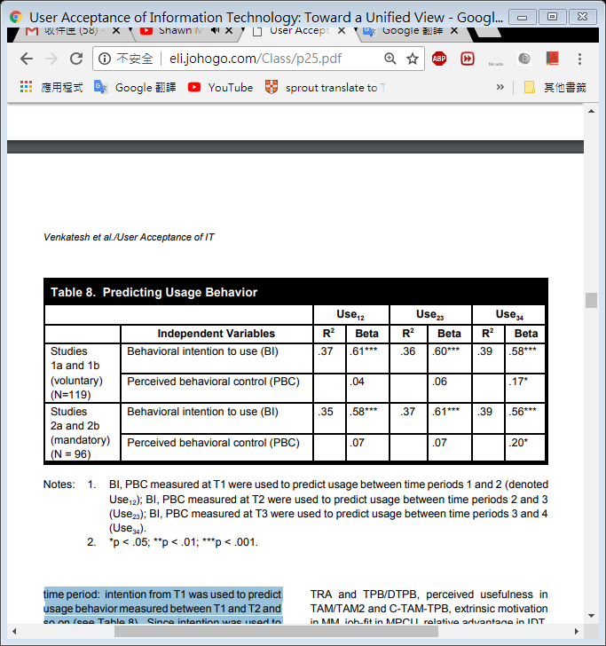
Result
Result
Intention and perceived behavioral control were used to predict behavior in the subsequent time period: intention from T1 was used to predict usage behavior measured between T1 and T2 and so on (see Table 8).
In addition to intention being a predictor of use, perceived behavioral control became a significant direct determinant of use over and above intention with increasing experience (at T3) indicating that continued use could be directly hindered or fostered by resources and opportunities.
Notes:
T1的意圖是被用在預測在T1和T2間測量的使用行為，並以此類推。
除了意圖決定使用之外，隨著時間的經過，「知覺行為控制(PBC)」與「促成條
件」也會直接影響使用。

Slide 36
Result
Result
Having reviewed and empirically compared the eight competing models, we now formulate a unified theory of acceptance and use of technology (UTAUT).
First, for every model, there was at least one construct that was significant in all time periods and that construct also had the strongest
Second, several other constructs were initially significant, but then became nonsignificant over time.
Finally, the voluntary vs. mandatory context did have an influence on the significance of constructs related to social influence.
Notes:
在回顧與比較這八個ModelS後，我們現在製定了UTAUT這個理論。
這個理論首先，在每個Model中的每個時期，都至少有一個construct是顯著的，
而這個Construct都擁有強烈的影響。
其次，其他幾種Constructs最初是顯著的，但隨著時間的推移的後會變得不顯著
。
最後，自願與強制性的環境確實會對與社會影響有關的Constructs產生顯著的影
響。

Slide 37
04
Formulation of the UTAUT
Direct determinants , Indirect determinants
Notes:
UTAUT模型希望將過去提到的model整合統一，而作者將前面8個model提到的constructs做了7個分類。

Slide 38
Determinants
Performance expectancy
Effort
expectancy
Self-efficiency
Anxiety
Direct determinants
Indirect determinants
Social
influence
Facilitating
conditions
Attitude
toward
using technology
Notes:
干擾變數: gender, age, voluntariness, experience

Slide 39
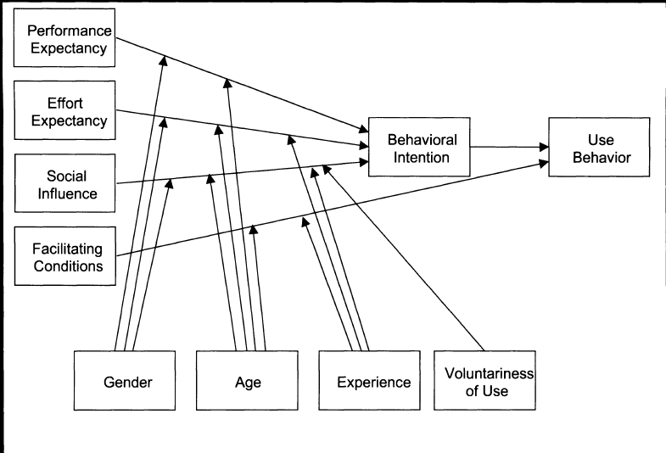
Formulation of the UTAUT (Determinants)

Slide 40
Direct determinants - Performance Expectancy
Definition：
The degree of an individual believes that using the system will help him or her to attain gains in job performance.
Constructs：
Perceived usefulness (TAM/TAM2 & C-TAM-TPB)
Extrinsic motivation (MM)
Job-fit (MPCU)
Relative advantage (IDT)
Outcome expectations (SCT)
Notes:
定義：指個人相信使用系統將會幫助他提升工作的績效。
→意指使用系統後可以獲得顯著的獎勵(Rewards)，例如：使用系統能增加生產力、使用系統能夠增加升遷機會等等。
Perceived usefulness (有用性認知):使用某種系統是否增加效能
Extrinsic motivation (外在動機):比起靠自己,透過系統可以有助於改善
Job-fit (工作適配度):系統擴大個人工作績效的可用性（工作與系統的相配度）
Relative advantage (相對優勢):使用創新系統會比原本的好
Outcome expectations (預期結果):如果使用了系統,可能會有助於提昇品質.產能等等因素.

Slide 41
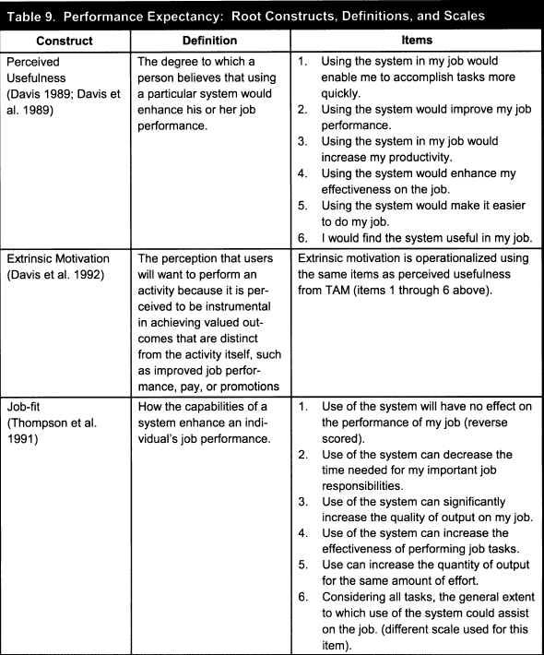

Performance Expectancy: Root Constructs , Definitions , and Scales

Slide 42
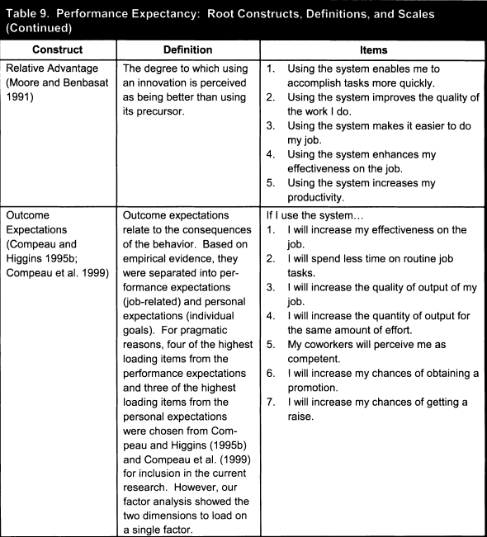

Performance Expectancy: Root Constructs , Definitions , and Scales

Slide 43
Performance Expectancy
Performance Expectancy: Root Constructs , Definitions , and Scales
Gender：
Men are more salient on task accomplishment.
Age ：
Younger workers place more importance on extrinsic
rewards.
Notes:
男性往往是高度地任務導向(highly task-oriented)
performance expectancy的重點在任務完成度，特別是指男性有較高的任務完成度。
”job-related attitudes”(與工作相關的態度)發現年輕員工可能更重視外在獎勵的部份。

Slide 44
Performance Expectancy
Performance Expectancy: Root Constructs , Definitions , and Scales
Hypothesis 1：
The influence of performance expectancy on behavioral intention will be moderated by gender and age, such that the effect will be stronger for men and particularly for younger men.
Notes:
在行為意圖上performance expectancy的影響將透過性別與年齡2個變數做調節，尤其是對於男性的影響更為強烈，特別是年輕的男性。

Slide 45
Direct determinants : Effort Expectancy
Definition：
The degree of ease associated with the use of the system.
Constructs：
Perceived ease of use (TAM/TAM2)
Complexity (MPCU)
Ease of use (IDT)
Notes:
定義：指個人認為使用系統的容易程度。
如：系統的操作是否容易、是否可以容易的理解。
perceived ease of use(知覺易用性):（使用之前的學習）容易上手的程度
Complexity:系統的複雜度
Ease of use :（正在使用系統）使用的困難程度

Slide 46
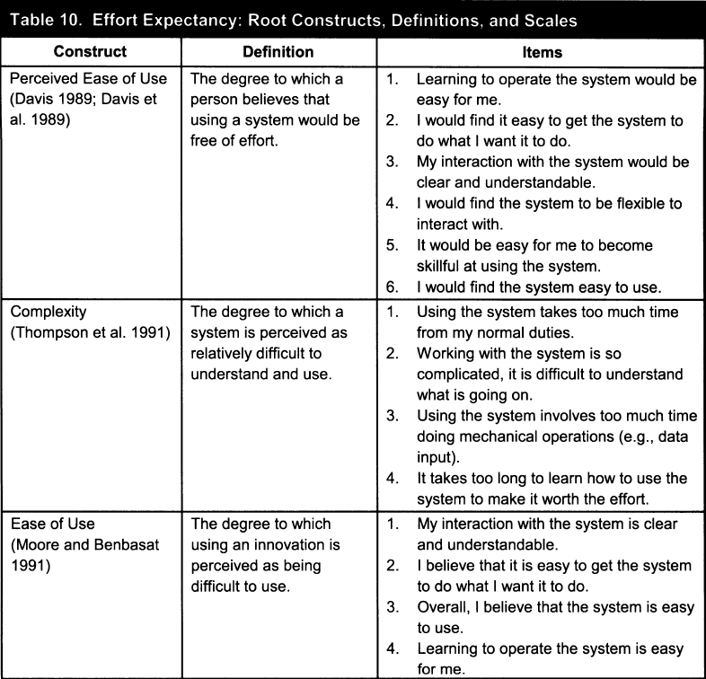

Effort Expectancy: Root Constructs , Definitions , and Scales

Slide 47
Direct determinants : Effort Expectancy
Gender：
Constructs will be stronger determinants of individuals` intention for women.
Age ：
Constructs will be stronger determinants of individuals` intention for older workers.
Experience：
Constructs will be more significant only during the first time periods.
Notes:
有學者研究指出女性比男性更顯著。

Slide 48
Direct determinants : Effort Expectancy
Hypothesis 2：
The influence of effort expectancy on behavioral intention will be moderated by gender, age, and experience, such that the effect will be stronger for women, particularly older women, and particularly at early stages of experience.
Notes:
在行為意圖上Effort expectancy的影響將透過性別、年齡與經驗3個變數做調節，尤其是對於女性;特別是年長的女性;以及少使用系統經驗的的影響更為強烈

Slide 49
Direct determinants : Social Influence
Definition：
The degree of an individual perceives that important others believe he or she should use the new system.
Constructs：
Subjective norm (TRA, TAM2, TPB/DTPB, and C-TAM-TPB)
Social factors (MPCU)
Image (IDT)
Notes:
定義：個人察覺重要的其他人(身邊對他而言有影響力的人)相信他或她應該使用新系統。
→意指將會受其他人的影響而去使用系統，例如：你的周遭朋友都在使用fb or plurk，你可能也會被影響而跟著使用。
subjective norm指的是”被週遭人賦予某種形象”、或者”被認為應該如何做”
social factors指的是”團體文化對於個人的影響”，例如：受到團體的價值觀,行為模式,思考方式等影響
image指的是”自認某種形象有利於維持或提升自己在團體中的地位”

Slide 50
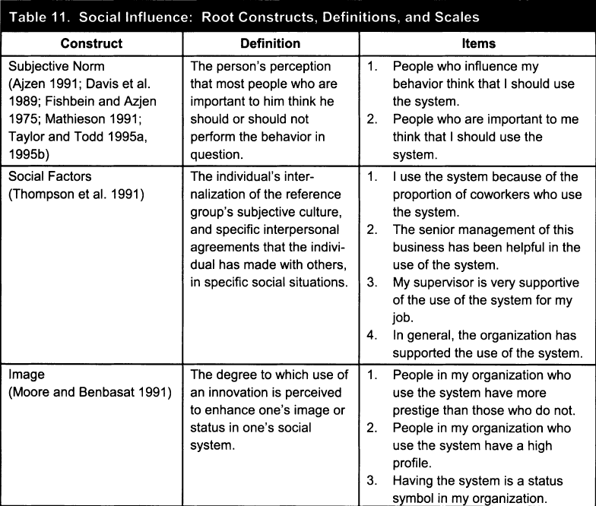
Social Influence: Root Constructs , Definitions , and Scales

Slide 51
Social Influence
Social Influence → Individual behavior
3 Mechanism:
Compliance
Identification
Internalization
Notes:
順從(compliance)，是指”個人接受影響以獲得他人的獎賞或避免他人的處罰”。
內化(internalization)，是指”個人接受團體的影響，漸漸團體行為與自己價值觀一致”。
認同(identification)，是指”只要和團體有一定關係，個人會接受他人指示改變自己的行為”。
在強制的情況下-影響個人行為的原因可能是順從(compliance)，造成社會影響對於行為意圖有直接的影響；(例如：為了回應社會的壓力下，造成個人順從(compliance)他人，而改變本身以符合社會。)
→相反，在自願的情況下-操作相關科技的話，影響個人行為的原因為內化(internalization)與認同(identification)。

Slide 52
Direct determinants : Social Influence
Gender：
Women tend to be more sensitive to other`s opinions.
Age & Experience ：
Older workers are more likely to place increased salience on social influences, with the effect declining with experience.
Voluntariness：
Constructs become significant when use is moderated.
Notes:
隨著年齡的增加，發現年長的工作者因為與他人的聯繫較多，所以可能使social influence的顯著性提升，但卻隨著經驗的增加而下降。

Slide 53
Direct determinants : Social Influence
Hypothesis 3：
The influence of social influence on behavioral intention will be moderated by gender, age, voluntariness and experience, such that the effect will be stronger for women, particularly older women, and particularly in mandatory settings in the early stages of experience.
Notes:
在行為意圖上Social Influence的影響將透過性別、年齡、自願性與經驗4個變數做調節，尤其是對於女性的影響更為強烈，特別是年長的女性，與早期階段的經驗。

Slide 54
Direct determinants : Facilitating Conditions
Definition：
The degree of an individual believes that an organizational and technical infrastructure exists to support use of the system.
Constructs：
Perceived behavioral control (TPB/DTPB, C-TAM-TPB)
Facilitating conditions (MPCU)
Compatibility (IDT)
Notes:
定義：個人認為組織及科技基礎建設的存在支援著該系統的使用。
→意指個人受到組織與相關科技方面對於系統使用的支持程度。EX：公司或組織是否支持你使用系統。
這些constructs的實施包含了各個方面的技術或組織環境，目的是在於”消除使用的障礙
perceived behavioral control的部分泛指使用者對系統的自我效能（self-efficacy）認定，也就是使用者對自己能否操作系統的判斷；
facilitating conditions(促進條件)是指客觀環境所提供的技術協助；
compatibility(相容性)則是系統與組織價值的「一致性」（consistency）

Slide 55
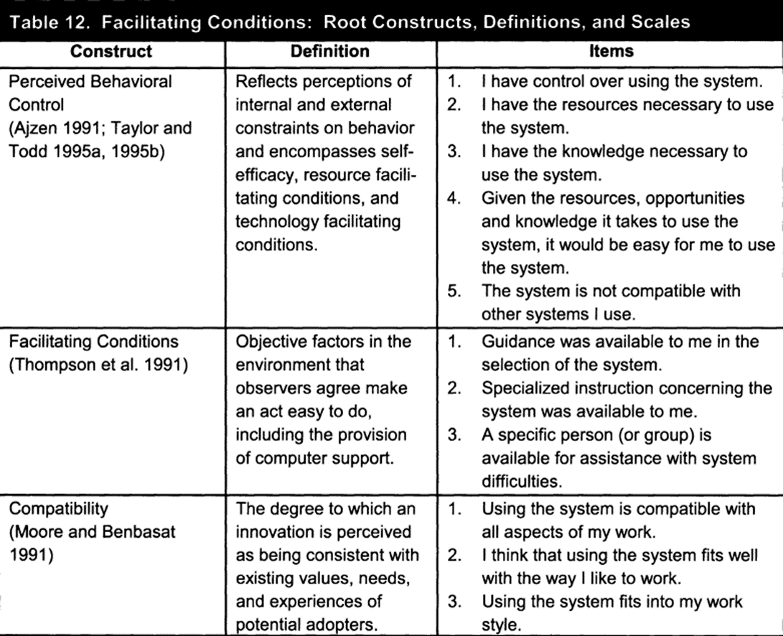

Facilitating Conditions: Root Constructs , Definitions , and Scales

Slide 56
Direct determinants : Facilitating Conditions
Hypothesis 4a：
Facilitating conditions will not have a significant influence on behavioral intention.
Notes:
因為支援的基礎建設已經被effort expectancy constructs中的使用容易程度所取代了
當performance與effort expectancy兩者都存在時，facilitating conditions則在行為意圖的預測上將會變得不顯著。

Slide 57
Direct determinants : Facilitating Conditions
Age ：
Older workers attach more importance to receiving help and assistance on the job.
Experience：
The effect is expected to increase with experience as users find multiple avenues for help and support.
Notes:
Age方面
組織心理學家指出，年長的工作者更加重視在工作上得到幫助與援助。
Experience方面
當科技的使用者隨著經驗的增加，而幫助與支援找到了多種方法，消除障礙以持續使用。

Slide 58
Direct determinants : Facilitating Conditions
Hypothesis 4b：
The influence of facilitating conditions on usage will be moderated by age and experience such that the effect will be stronger for older workers, particularly with increasing experience.
Notes:
在使用行為上facilitating conditions的影響將透過年齡與經驗2個變數做調節，尤其是對於對於年長的工作者的影響更為強烈，特別是在經驗增加的時候

Slide 59
Indirect determinants : Self-efficiency & Anxiety
Hypothesis 5a：
Compute self-efficiency will not have a significant influence on behavioral intention.
Hypothesis 5b：
Compute anxiety will not have a significant influence on behavioral intention.
Notes:
自我效能＆焦慮在容易使用的前提下,也會變的不顯著（已經容易使用了,不會需要要求本身的效能,使用者也不會焦慮）
self-efficacy及anxiety是透過” 知覺易用性，perceived ease of use”直接影響行為意圖。所以self-efficacy及anxiety是間接的決定因素，可以完全被perceived ease of use所取代。

Slide 60
Indirect determinants : Attitude toward using technology
Definition：
An individual`s overall affective reaction to using a system.
Constructs：
Attitude toward behavior (TRA,TPB/DTPB, C-TAM-TPB)
Intrinsic motivation (MM)
Affect toward use (MPCU)
Affect (SCT)
Notes:
attitude toward behavior(對行為的看法)：在執行目標行為時，每個人自己的正面或負面想法。
intrinsic motivation(內在動機)：我們發自內心去進行一件事情如:練英文,打球等等,而不是因為獎賞等外在因素來促使我們
affect toward use(對使用的影響)：每個人的對於特定act的情緒感覺（使用了某系統的使用感到喜怒哀樂等情緒。）
affect(影響)：一個人本身的喜好。

Slide 61
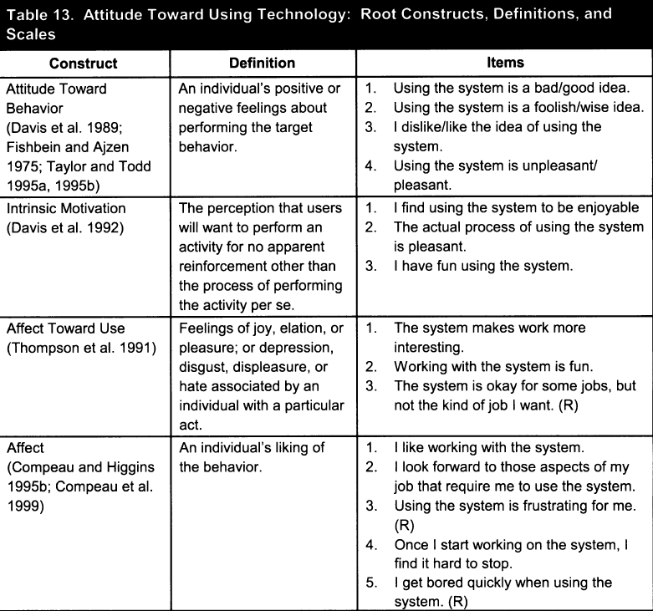

Attitude toward using technology: Root Constructs , Definitions , and Scales

Slide 62
Attitude toward using technology
Hypothesis 5c：
Attitude toward using technology will not have a significant influence on behavioral intention.
Notes:
態度的constructs在橫跨三個時間點(T1,T2,T3)有顯著影響(例：TRA, TPB/DTPB & MM)和對於行為意圖的預測是強烈的。然而，在其他的constructs(C-TAM-TPB, MPCU & SCT)則沒有顯著的影響。
所以態度constructs只有在特別的認知時才會顯著(例如：performance與effort expectancy的constructs)不包含在模型中。

Slide 63
Behavioral Intention
Hypothesis 6：
Behavioral intention will have a significant positive influence on usage.
Notes:
對於在paper中討論的所有行為意圖模型(intention models)都與基礎理論一致，所以作者期望行為意圖將對於使用系統方面有顯著的正向影響。

Slide 64
05
Empirical Validation of UTAUT
Preliminary Test of UTAUT , Cross-Validation of UTAUT

Slide 65
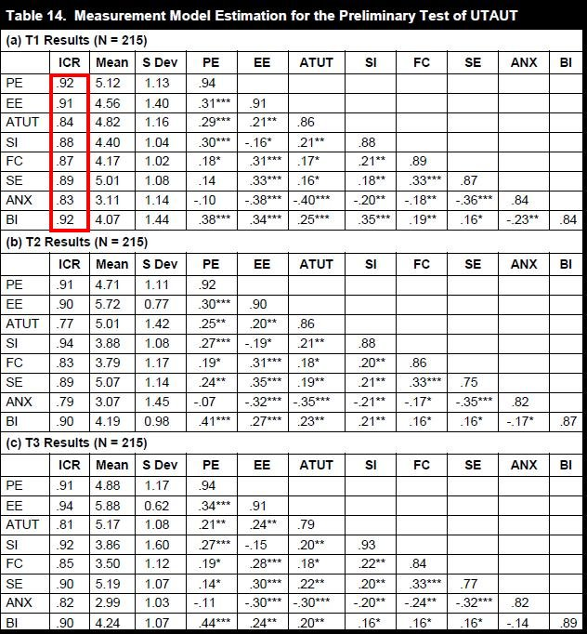
Measurement Model Estimation for the Preliminary Test of UTAUT

Slide 66
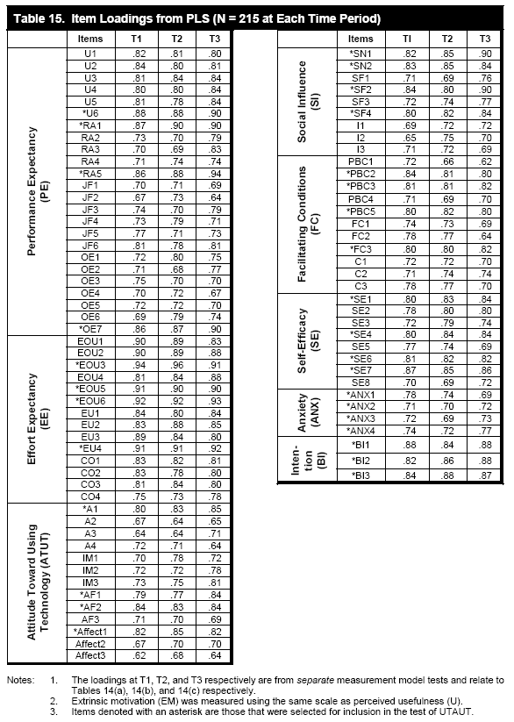
Item Loadings from PLS(N=215 at Each Time Period)

Slide 67
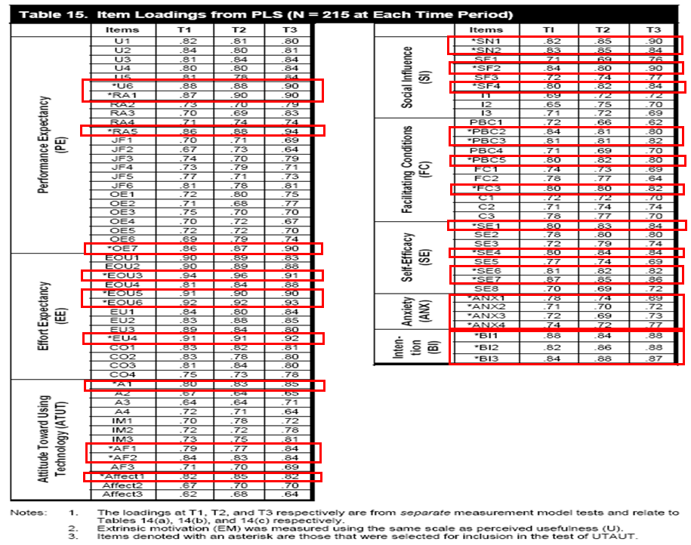
Item Loadings from PLS(N=215 at Each Time Period)

Slide 68
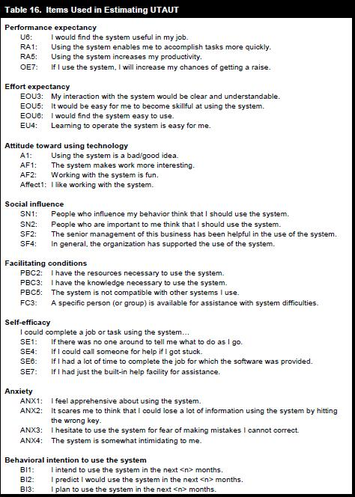
Items Used in Esimating UTAUT

Slide 69
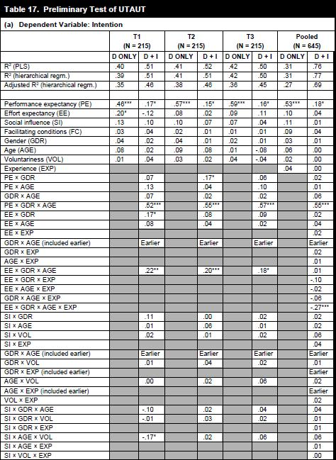
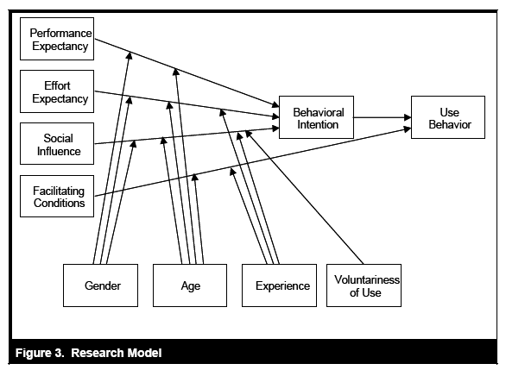
Preliminary Test of UTAUT

Slide 70
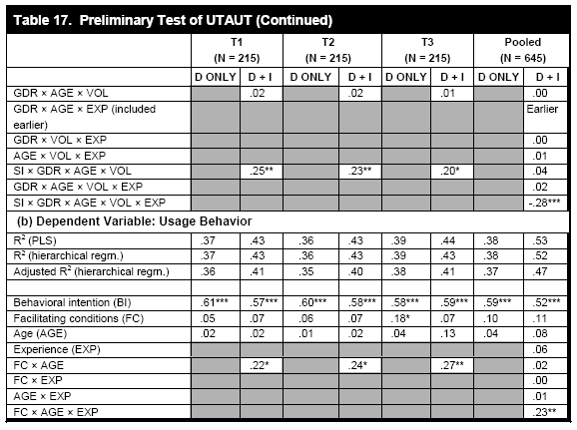
Preliminary Test of UTAUT(Continued)

Slide 71
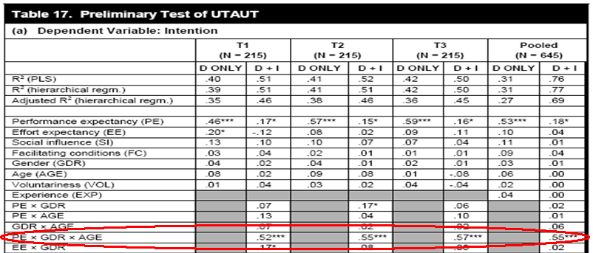
Performance expectancy(PE)
Ｈ１：The effect was moderated by gender and age such that it was more salient to younger workers, particularly men.

Slide 72
Supporting H1
Effect is stronger for men and younger workers.
H1

Slide 73
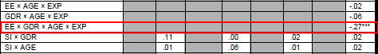
Effort expectancy(EE)
Ｈ２：The effect was moderated by gender and age, and the effect decreases with experience.

Slide 74
Supporting H2
Effect is stronger for women, older workers, and those with limited experience.
H2

Slide 75
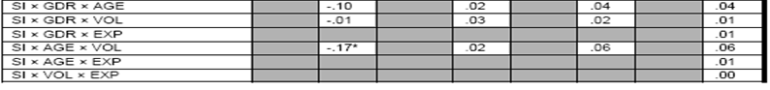
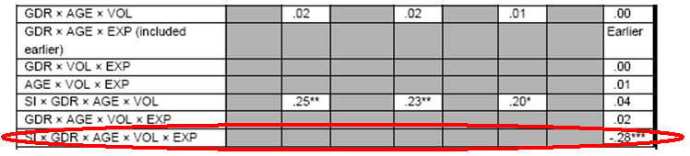
Social influence(SI)
Ｈ３：Its role is more important in the context of mandatory use, more so among older women, and even more significant in the early stages of individual experience with the technology.

Slide 76
Supporting H3
H3
Effect is stronger for women, older workers, under conditions of mandatory use, and with limited experience

Slide 77
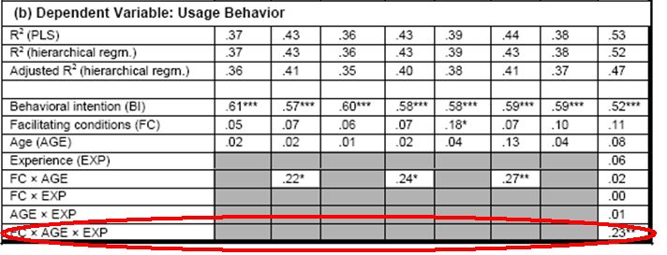
Facilitating condition(FC)
Ｈ４ｂ：In predicting usage behavior, facilitating conditions were significant, with the latter’s effect being moderated by age (more important to order workers), and with increasing experience.

Slide 78
Supporting H4b
Effect is stronger for older workers with increasing experience.
H4b

Slide 79
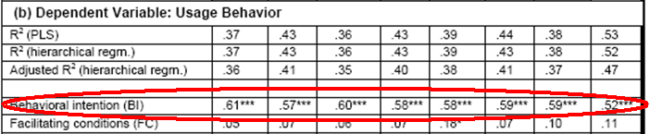
Behavioral intention(BI)
H6：In predicting usage behavior, the effect of behavior intention were significant.

Slide 80
Supporting H6
Direct effect
H6

Slide 81
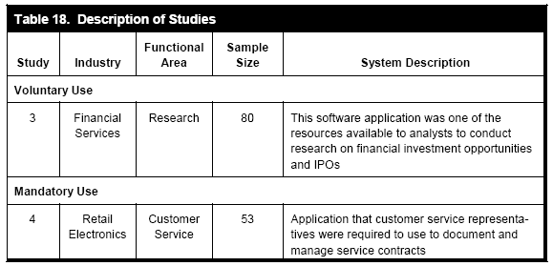
Cross-Validation of UTAUT

Slide 82
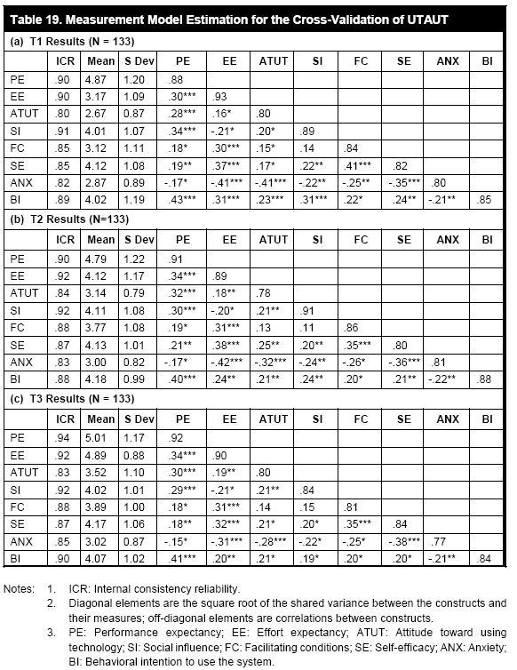
Measurement Model Estimation for the Cross-Validation of UTAUT

Slide 83
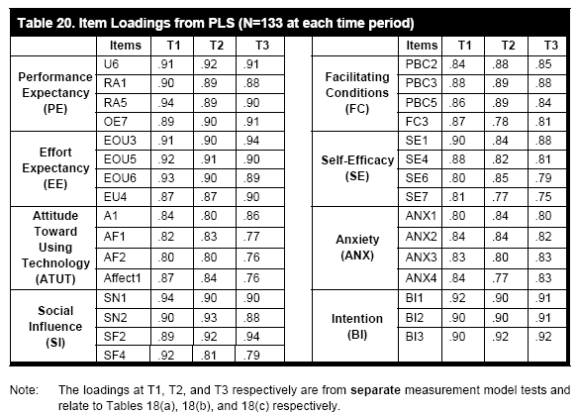
Item Loadings from PLS(N=133 at Each Time Period)

Slide 84
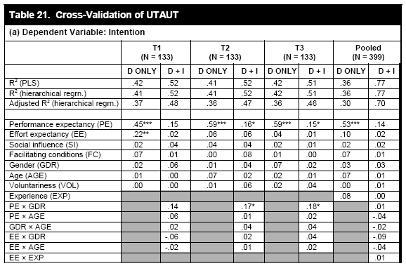
Cross-Validation of UTAUT

Slide 85
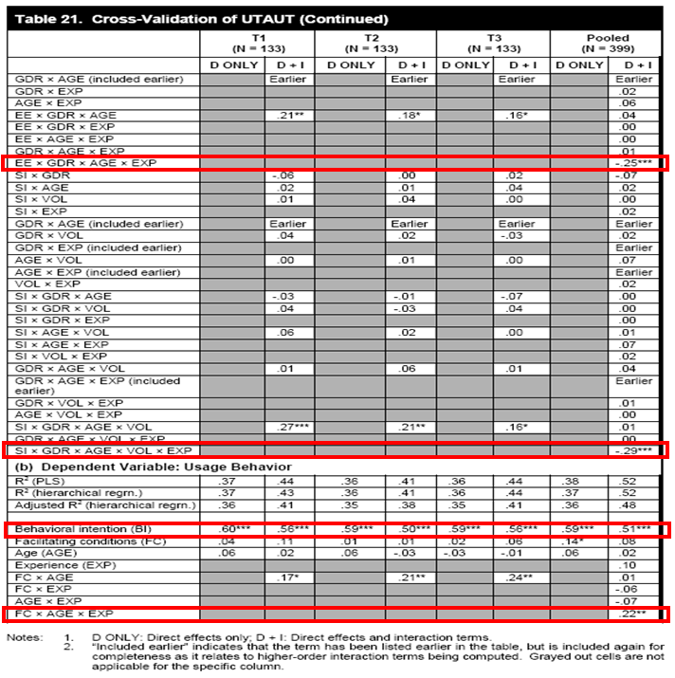
Cross-Validation of UTAUT(Continued)

Slide 86
6
Conclusion

Slide 87
Conclusion
UTAUT provides a refined view of how the determinants of intention and behavior evolve over time
Social influence construct has been controversial
Focus on integrating UTAUT with research that has identified causal antecedents of the constructs used within the model

Slide 88
Conclusion
Study the degree to which systems perceived as successful from an IT adoption perspective are considered a success from an organizational perspective
Account for dynamic influence

Slide 89
Contribution
UTAUT was able to account for 70 percent of variance
Integrate the main 32 effects and 4 moderator into 4 main effects and 4 moderators

Slide 90
Thanks for listening!!
Q&A

